Slide 1

Waze User Churn Project
Preliminary Data Summary
The Waze team is seeking to understand the factors that influence user churn, and develop a predictive model to identify users at risk of leaving the platform. Through exploratory data analysis, feature engineering and machine learning, key drivers of churn can help generate actionable business recommendations aimed at improving user retention.
Currently, we are in the early stages of understanding data
Understanding data, checking descriptive statistics for each column
Looking at breakdowns of users who churned vs. users who haven’t churned, to see which variables may provide more insights.
Feature engineering: Developing new features from the current data
There were 700 null rows, each without the label status of the row
64% of users own iphones, 36% own Androids
Churned users had more km driven and minutes drove, but for some reason, less driving and activity days.
Km per drive: the retained users median was 75, churned users median = 74
Km per driving day: Churned users = 697.5, retained = 289.5 km/driving day
Iphone and Android ratio for churned and retained was both 64% and 36%, which may indicate that this doesn’t have an effect on whether users churn
Research the reason why churned users may have driven more km and more minutes driven
Create graphs, histograms, and plots to discover more insights into relationships between variables
Look into km per driving day, as churned users had a significantly higher median of km/driving days

Slide 2
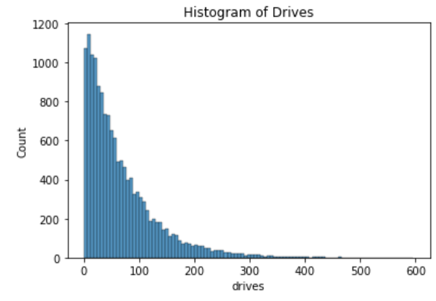
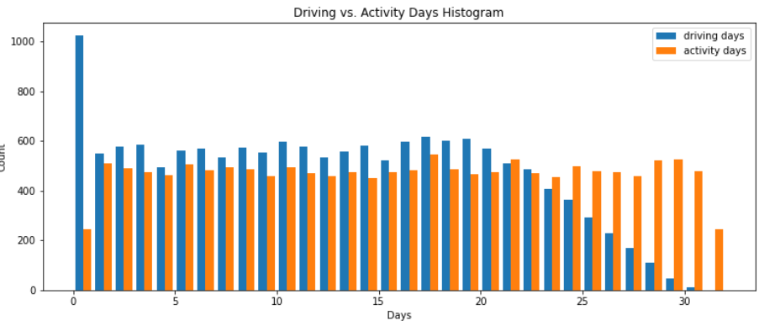
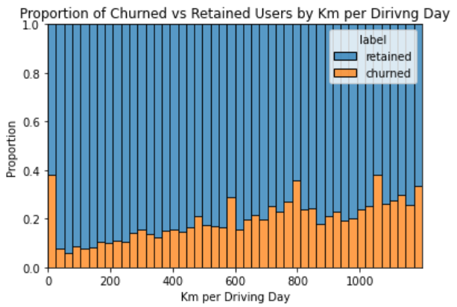
Title: Waze User Churn Project
Exploratory Data Analysis Insights
Waze has experienced user churn, with some users uninstalling the app over time. To better understand the factors associated with churn and support future machine learning efforts, we conducted an exploratory data analysis to identify key trends and prepare the data for further analysis.
Histogram of Number of Drives: Right skewed, with most drivers between 0-200 drives. Few drivers with more than 400 drives
Our objective is to identify factors that contribute to user churn and uncover opportunities to improve user retention. To support this goal, we conducted an exploratory data analysis (EDA) to better understand user behavior, engagement patterns, and key characteristics associated with churn. The insights gained can help inform strategies at reducing churn and increasing long-term user-retention rates.
Driving vs. Activity Days: Number of activity days exceeded number of driving days.
Proportion Of Churned vs Retained Users by Km per driving day: Churn rate tended to increase as the mean daily distance driven increased
The insights from the analysis provide a better understanding of user behavior and engagement patterns. These findings can help inform future retention strategies, guide feature improvements, and support the development of predictive models.
Driving vs Activity Days: The number of activity days exceeded the number of driving days. This can be explained by the fact that sometimes people may open the app without booking a ride, or may engage with the app for other reasons other than to find a ride.
Skewed Data Distribution: The number of sessions and drives during the month formed a right-skewed pattern. The median number of drives was only 48, but a select few people had gone over 400 drives.
Churn rate: Churn rates tended to increase as the mean daily distance increased. Some potential reasons for this may include the fact that heavier users may have higher expectations, or longer distance drivers may be occasional travelers.
Our exploratory data analysis revealed several key considerations, including the right-skewed distribution of the data and a relationship between churn and mean daily distance driven. Further analysis of these patterns may provide valuable insights that Waze can use to improve user retention and reduce churn.

Slide 3

User Churn Project - Two-Sample Hypothesis Test Results (Apple vs. Android)
Prepared for: Waze Leadership Team
This analysis examined whether there is statistical significance between the average number of rides between iPhone and Android Users. We performed a 2-sample hypothesis to determine whether each device type is associated with differences in user engagement
The leadership is requesting an analysis to determine whether having an iPhone vs having an Android influences user activity. This can help Waze decide how to develop their product for each group of people. A two-sample t-test was performed to compare the mean number of rides between iPhone and Android users. The statistical significance was evaluated at an alpha level of 0.05.
We obtained a t-statistic of 1.46 and a p-value of 0.143, which is greater than 0.05. Since p = 0.143 > 0.05 we cannot conclude that iphone users go on more (or less) drives than Android users.
Based on calculations, the iphone users went on more drives on average than android
The t-test concluded there is not a statistical significance between number of drives of iphone and android users
Investigate other factors that may have a stronger impact on user engagement and churn, such as activity days, driving frequency
Continue developing the churn prediction model using behavioral metrics
Monitor iPhone and Android platforms to ensure consistent performance

Slide 4
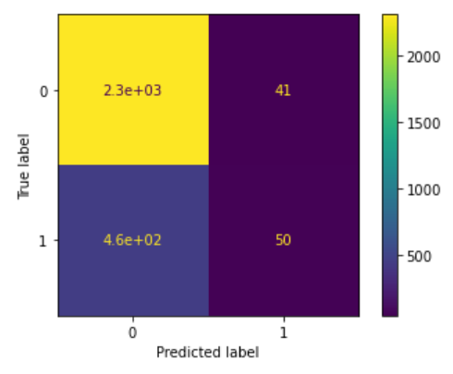
User Churn Project | Regression Modeling Results
Prepared for: Waze Leadership Team
In this section, we developed and evaluated a logistic regression model to predict user churn based on user activity and engagement metrics. We analyzed the model’s performance using classification metrics and examined importance of features to identify factors that were most strongly associated with churn. The results provided insights into key churn drivers, highlighting the model’s predictive strengths and limitations and helped identify opportunities for improving future churn prediction efforts.
Target Goal
Developed predictive model to identify which users are likely to churn
Methods
Prepared and engineered features for churn prediction analysis
Built logistic regression model to estimate probability of user churn
Evaluated model performance using confusion matrix, precision, and recall
Analyzed model coefficients and feature importance
Impact
Identify key factors influencing user churn
Assessed model’s ability to predict churn and highlighted ways for improvement
Providing actionable insights to support future user-retention strategies
Precision: 0.549
Recall: 0.0986
When the model predicts that a user will churn, it is correct 54.9% of the time
However, the model identifies only 9.86% of the users who actually churn, indicating that most churning users are not being detected
The model demonstrates moderate precision but very low recall, suggesting it is highly conservative in predicting churn
Activity Days Was by far the most important variable. Activity days had a negative correlation with user-churn
Due to the results of the model, we should not solely rely on this model and perform further exploration into the data.
Add more Features
Analyze different ratios, such as sessions per day, or drives per active day.
Analyze recent activity trends, such as a 30-day activity change week-over-week for each feature to see if there are trends of usage amongst the 30 days.
Test other models
Test other models, such as random forest and Gradient Boosting to see if those models can more accurately predict model results

Slide 5
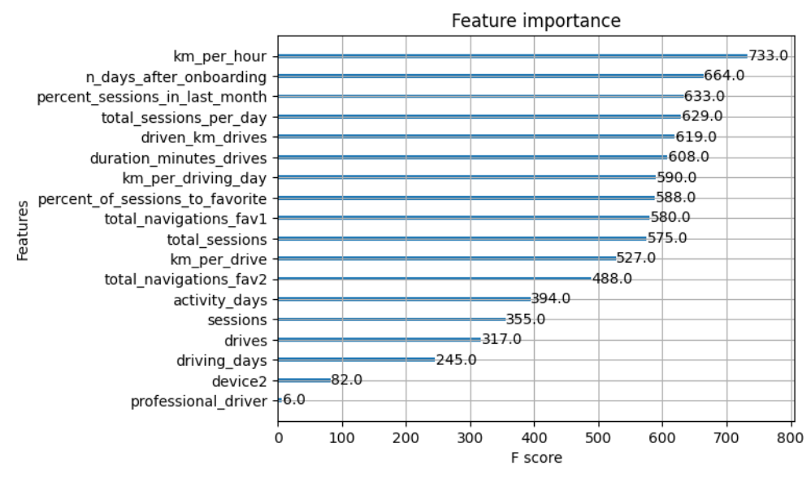
User Churn Project | Random Forest and XGBoost
Prepared for: Waze Leadership Team
Performed feature engineering to create new predictors, including km per hour, professional driver, total sessions per day, and other user engagement metrics
Split data into train, validation and test datasets to support model development and evaluation
Built and evaluated Random Forest and XGBoost classification models, using GridSearch to identify the best-performing hyperparameter combinations
Evaluated model performance, using accuracy, precision, recall, and F1 score, selecting the strongest model based on ability to identify user risk of churn
Tested champion model on unseen data and analyzed results to assess effectiveness in predicting user churn
Created confusion matrix and feature importance graph to interpret model performance and identify variables most strongly associated with churn
Waze is seeking to reduce user churn by identifying users who are likely to stop using the application. Without effective proactive solutions, retention efforts may be reactive, and a machine learning model can help predict churn based on different activity patterns. To address this challenge, machine learning models such as Random Forest and XGBoost were evaluated to predict churn based on user activity and engagement patterns.
This model requires more training data and features in order to accurately make predictions over the data.
This model demonstrates an 80% accuracy level, but we only end up with a recall of 18% and F1 score of 24%
Therefore, this model can be used with caution, and used for insight purposes. Waze may want to avoid using it to drive business decisions.
In order to achieve a better model, we could add additional features including other ratios, such as drives per activity day, navigation rate, activity ratio, weekend vs. weekday usage patterns (if available), and trend/change in activity overtime.
Engineered features have high feature importance: Including Km per hour, percent_sessions_in_last_month, total_sessions_per_day, driven_km_drives, duration_minutes_drive
XGBoost model performed better than Random Forest: XGBoost model had higher precision, recall, F1, and accuracy rates
Even though XGBoost performed better, it is harder to classify the importance and magnitude of each feature in comparison to Logistic Regression: Logistic regression has coefficients that can help model interactions and look at the tangible effect of multiple variables.

